Slide 1
Smart University: AI Based Administration

Slide 2


Slide 3


Slide 4
Agenda
- Use case Diagram
- Class Diagram
- Sequence Diagram(s)
- Epilogue
- Next?

Slide 5
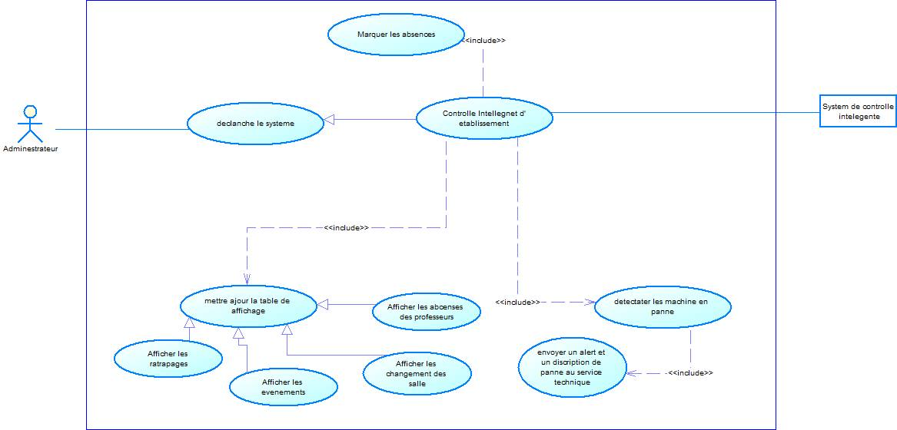
Use case Diagram

Slide 6
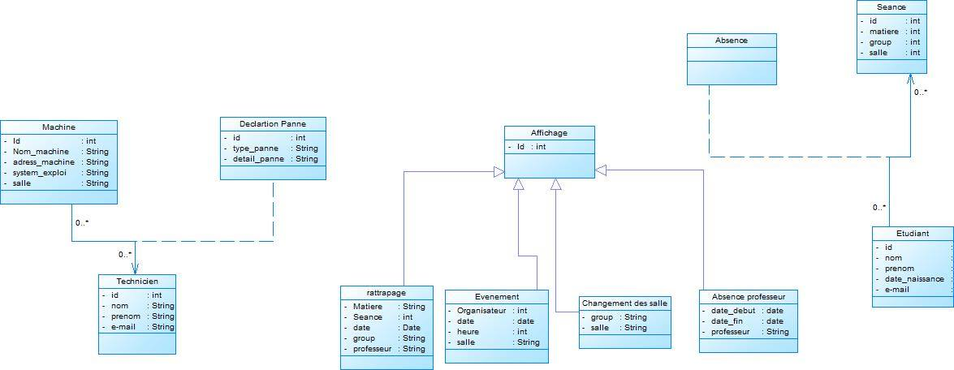
Class Diagram

Slide 7
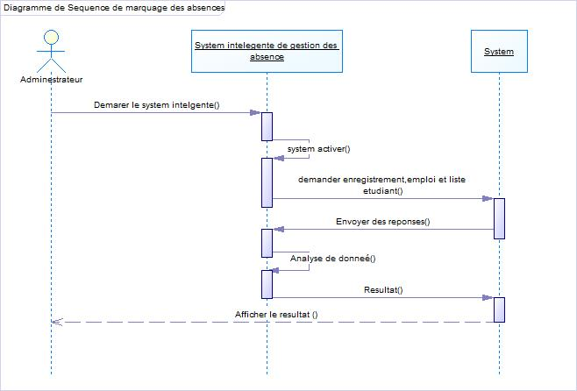
Sequence Diagram: Absence

Slide 8
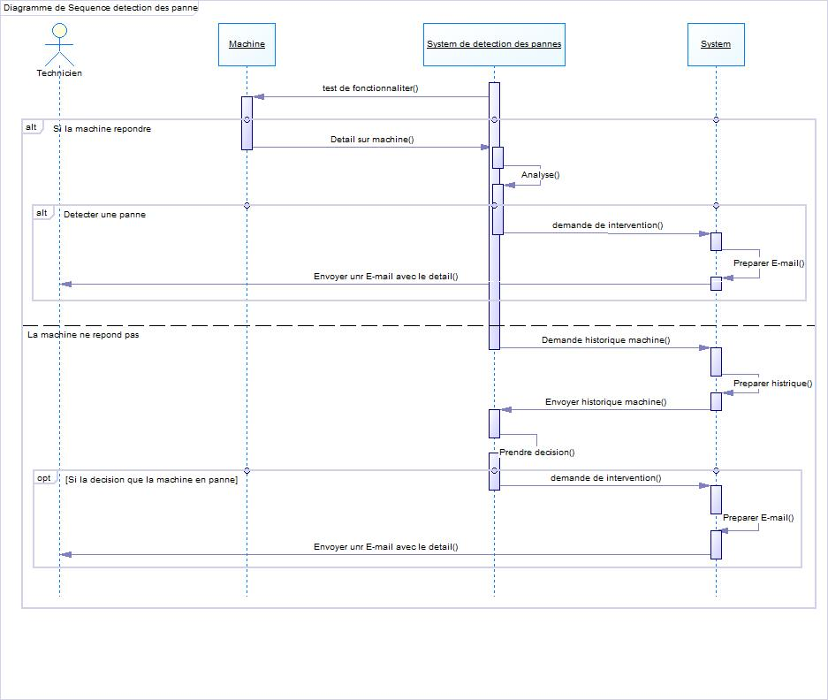
Sequence Diagram: Catch crashes

Slide 9
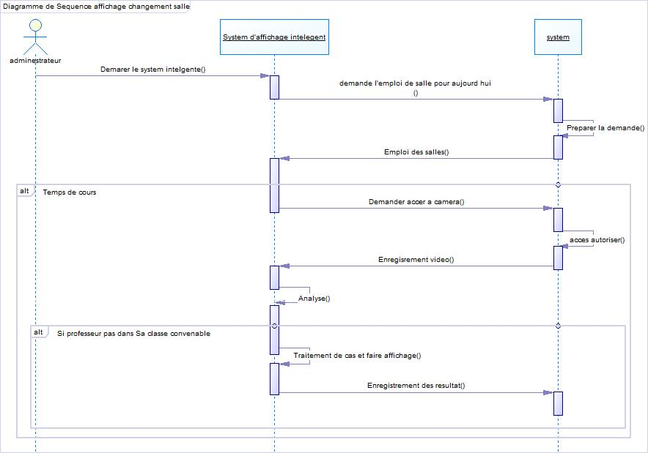
Sequence Diagram: classroom ch anger

Slide 10
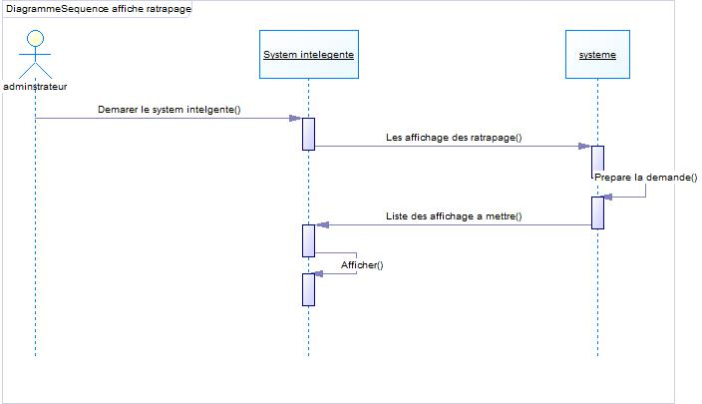
Sequence Diagram : Extra Courses Display

Slide 11
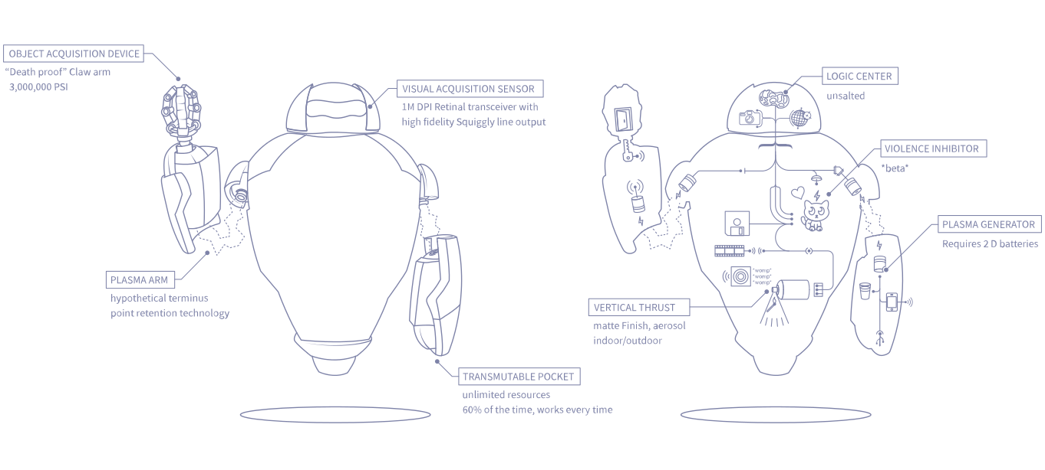
Next? Hello HubBot!

Slide 12
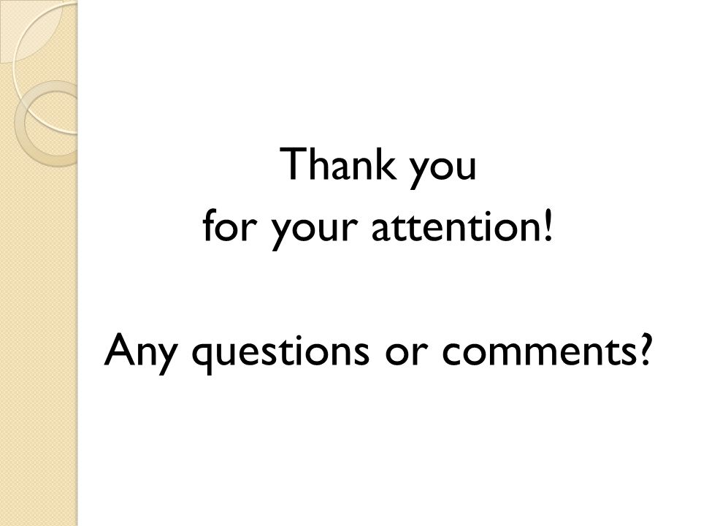
Are we there yet ?

